Slide 1
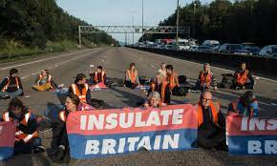
Public Nuisance
John Murphy

Slide 2
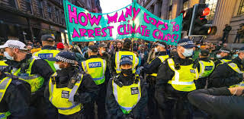
PUBLIC NUISANCE
I Introduction
Public nuisance is an oddity, captured beautifully by Spencer as follows:
“Why is making obscene telephone calls like laying manure in the street? Answer: in the same way as importing Irish cattle is like building a thatched house in the Borough of Blandford Forum; and as digging up the wall of a church is like helping a homicidal maniac to escape from Broadmoor; and as operating a joint stock company without a Royal charter is like being a common [s]cold; and as keeping a tiger in a pen adjoining the highway is like depositing a mutilated corpse on a doorstep.”
For there to be a public nuisance, there must be an infringement of a public right (which tallies with their criminality).
They involve a common injury to a broad class of His Majesty’s subjects elsewhere than on their premises.
R v Rimmington; R v Goldstein [2008] 1 AC 459
Cf A-G v PYA Quarries [1957] 2 QB 169
BUT this is wrong in law. Public nuisances have at their heart public rights not (like private nuisance) private rights.
Most public nuisance case involve the blockage of highways and other thoroughfares.
Rose v Miles (1815) 4 M & S 101

Slide 3

II First: Is Public Nuisance part of Tort Law?
(a) Nick’s McBride:
“[It is] a strange sort of tort, if it is a tort at all”.
(b) Common Law Orthodoxy
(c ) My View
It all depends how you define a tort… and views do vary!
Key point:public nuisances involve public duties/rights – thus hard to see it as part of private law
The courts have always treated public nuisance as part of tort law.
There is nothing especially or necessarily neat and tidy about tort law
“the duty that someone breaches … is a duty imposed for the benefit of the public as a whole”.
We must take what the courts say seriously when we create maps of the law.

Slide 4
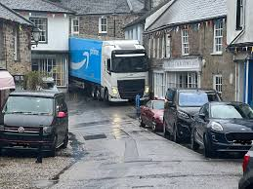
III Necessary Land Connection?
It follows from the many obstructed highway cases that there needn’t
be a proprietary interest on C’s part
Nor need there be any such ownership/interest on D’s part.
Gillingham BC v Medway (Chatham) Dock [1993] QB 343
IV How Public is Public?
For a public nuisance to be actionable in tort, it must affect a broad range of people (a broad class of the citizenry).
A-G v PYA Quarries (supra)
“public nuisance is a nuisance which is so widespread in its range or so indiscriminate in its effect that it would not
be reasonable to expect one person to take proceedings on his own responsibility to put a stop to it, but that it
should be taken on the responsibility of the community at large”. (Denning LJ)
Shek Sze Ming v Yiu Yuet Sim [2015] HKEC 1826

Slide 5
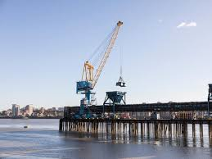

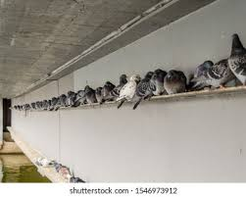
V Particular Damage? Not only must C show membership of relevant class, s/he must also show damage suffered went above and beyond that suffered by the other members of the class.
Tate & Lyle Industries Ltd v Greater London Council [1983] 2 AC 509
Trevett v Lee [1955] 1 WLR 113
NB Wilkes v Hungerford Market (1835) 2 Bing NC 281.
VI Personal Injury?
Although the tort of private nuisance will not tolerate claims for personal injury per se (see Hunter v Canary Wharf, supra) public nuisance will permit such claims.
In re Corby Group Litigation [2009] 2 WLR 609
Chung Man Yau v Sihon Co Ltd [1996] 3 HKC 614
VII Who is Liable for a Public Nuisance?
If one deliberately creates a nuisance one is liable. If one does so inadvertently but knew/ought to have known one would result
R v Goldstein [2008] 1 AC 459
Wandsworth LBC v Railtrack [2002] QB 756

Slide 6

Next, we’ll do...
… ish

